Slide 1
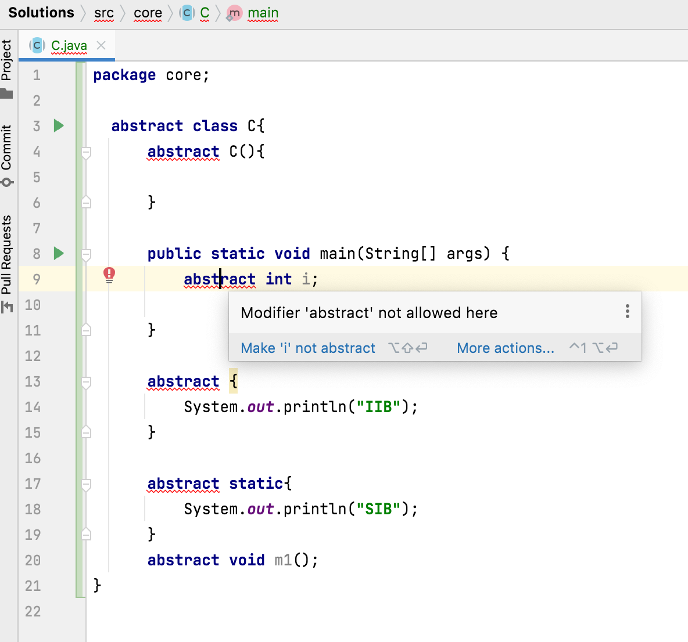


Can we use abstract keyword with constructors?
No
Constructor
Static Initialization Block
Instance Initialization Block
variables
can not be abstract.

